Slide 1
LAW OF DEMAND AND ITS EXCEPTIONS

Slide 2

Do You Know
What Is
DEMAND?

Slide 3
Demand is an economic principle referring to a consumers desire to purchase goods and services and willingness to pay a price for a specific good or service. Holding all other factors constant , an increase in the price of a good or service will decrease the quantity demanded, and vice versa.

Slide 4
LAW OF DEMAND
The law of demand states that all other things being equal, the quantity bought of a good or service is a function of price. As long as nothing else changes, people will buy less of something when its price rises . They will buy more when its price falls.

Slide 5
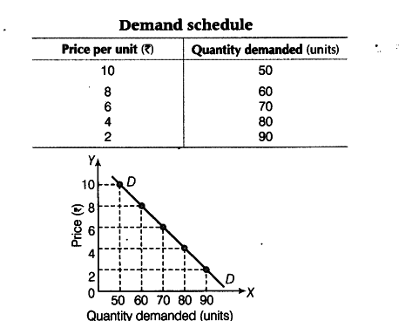
Explanation Of Law Of Demand

Slide 6
DEMAND FUNCTION
This shows the relationship between the demand of a commodity and its determinants.
Y = Income of the consumer
P x = Price of the commodity X
Ps = Price of substitution goods of X
Pc = Price of complementary goods of X
T = Taste and preference of the consumers
E p = Future price expectations
E y = Future income expectations
N = Number of Consumers
D = Distribution of consumers
μ = Some other determinants
D x = f(Y , P x , Ps, Pc , T , E p , E y , N , D ,μ)

Slide 7
ELASTICITY of the demand
According to the Marshall “The degree responsive change in Quantity demanded to its change in price or any other determinants of demand” is defined as Elasticity of demand.

Slide 8
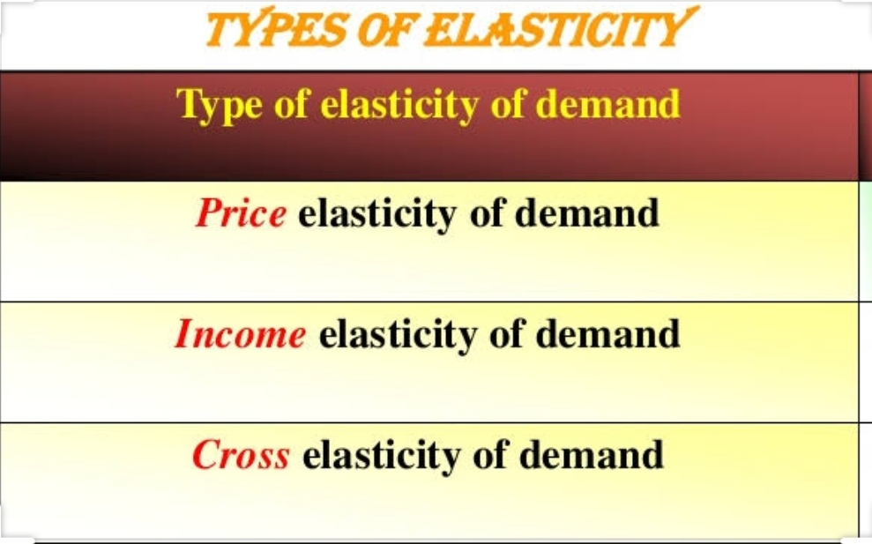

Slide 9
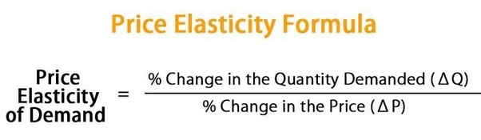
PRICE ELASITICITY OF DEMAND
Price elasticity of demand (PED or E d ) is a measure used in economics to show the responsiveness, or elasticity, of the quantity demanded of a good or service to increase in its price when nothing but the price changes. More precisely, it gives the percentage change in quantity demanded in response to a one percent change in price.

Slide 10
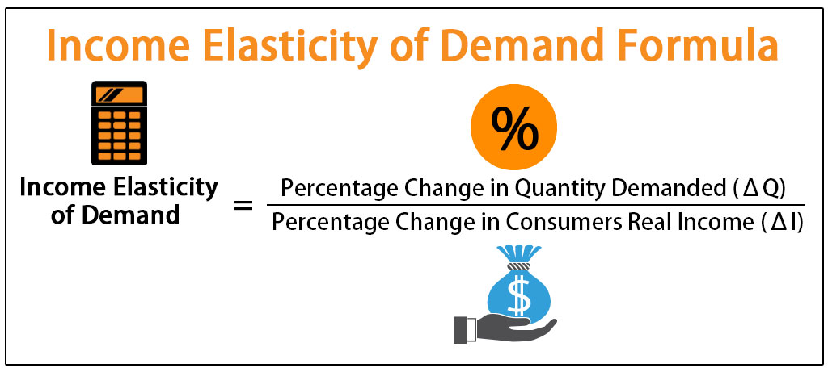
INCOME ELASTICITY OF DEMAND
The formula for calculating income elasticity of demand is the percent change in quantity demanded divided by the percent change in income. With income elasticity of demand, you can tell if a particular good represents a necessity or a luxury.

Slide 11
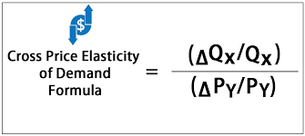
CROSS ELASTICITY OF DEMAND
The cross elasticity of demand is an economic concept that measures the responsiveness in the quantity demanded of one good when the price for another good changes.

Slide 12
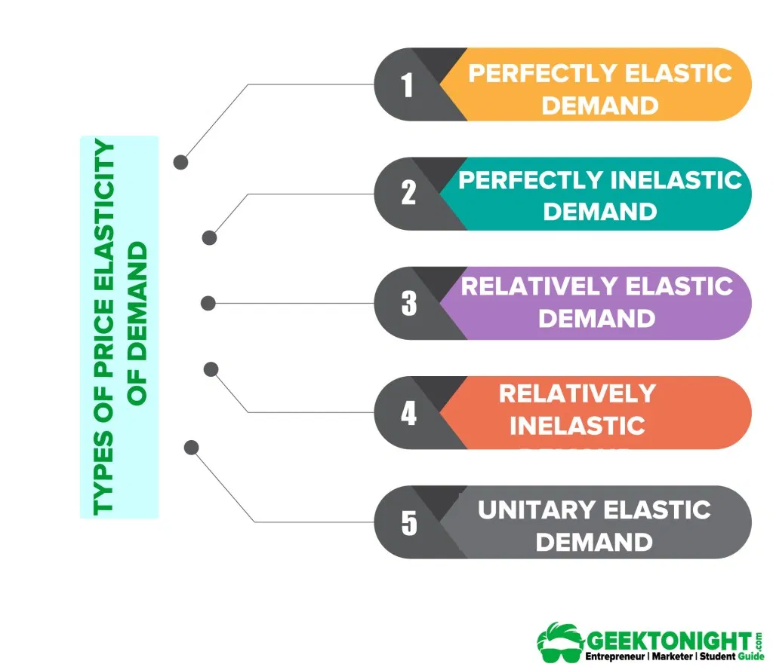
TYPES OF PRICE ELASTICITY OF DEMAND

Slide 13
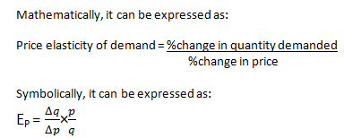
Price Elasticity of Demand
The price elasticity of demand is defined as the percentage change in quantity demanded due to
certain percentage change in price

Slide 14
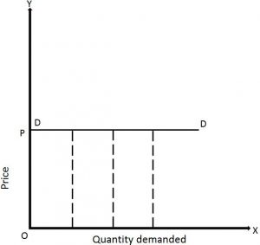
1.Perfectly Elastic Demand( E_{P} = ∞)
The demand is said to be perfectly elastic if the quantity demand increases infinitely with a small fall in price (or) quantity demanded falls to zero with a small rise in price.
Thus, it is also known as
Infinite Elasticity.

Slide 15
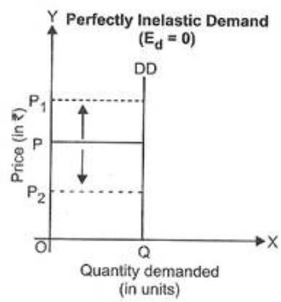
2.Perfectly Inelastic Demand (E_{P} = 0)
The demand is said to perfectly inelastic if the demand remains
constant whatever may be the price.
Thus, it is also known as
Zero Elasticity.

Slide 16
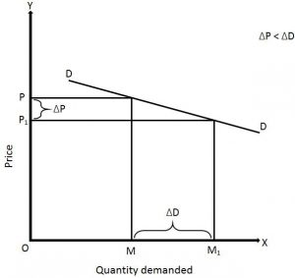
3.Relatively Elastic Demand(E_{P}> 1)
The demand is said to be relatively elastic if the percentage change in demand is (>) the percentage
change in price (i.e) there is a greater change in demand there is a small change in price.
Also known as Highly Elastic Demand (or) Simply elastic Demand.

Slide 17
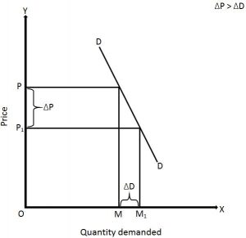
4. Relatively Inelastic Demand(E_{p}< 1)
The demand is said to be relatively inelastic if the percentage change in price (i.e) if there is a small change in demand with a greater change in price.
It is also called Less Elastic (or) Inelastic Demand.

Slide 18
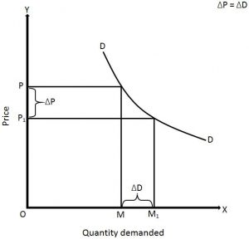
5.Unitary Elastic Demand (E_{p} = 1)
The demand is said to be unitary elastic if the percentage change in quantity demanded is equal to the percentage change in price.
In such type of demand, 1% change in price leads to exactly 1% change in quantity demanded.

Slide 19
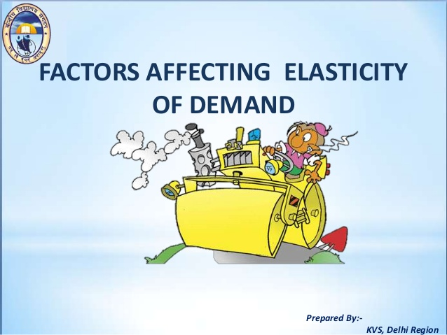

Slide 20
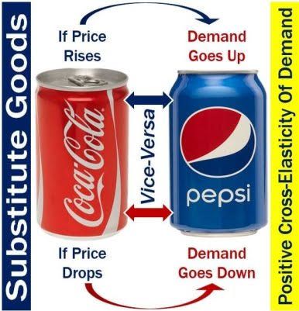
1. Substitute goods : The more good substitutes there are, the more elastic the demand will be.

Slide 21
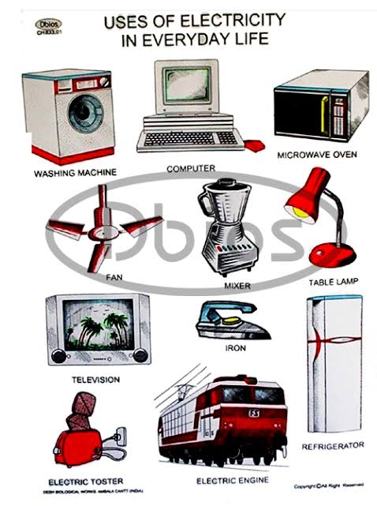
2. Position :The larger the percentage of consumer’s income spent on a product the more elastic will be its de­mand.
3.Number of uses : The greater the number of uses of a commodity, the greater its elasticity of demand.

Slide 22

4.POSSIBILITY OF POSTPONEMENT:
Implies that goods whose demand can be postponed by consumers to a near future, then the demand would be highly elastic. For example, purchasing a car and renovating a building can be postponed; therefore, their demand is highly elastic.

Slide 23
5.JOINT DEMAND:
The elasticity of demand of the second commodity depends upon the elasticity of demand of the major commodity
If the demand for, say, bread is elastic, the demand for jam will also be elastic.
6.Time period :
Demand is more price elastic, the longer that consumers have to respond to a price change. They have more time to search for cheaper substitutes and switch their spending.

Slide 24

7.HABITS:
People who are habituated to the consumption of a particular commodity, like coffee, tea or cigarette of a particular brand, the demand for it will be inelastic. We find that the prices of coffee, tea increase almost every year but there has been little effect on their demand because people are in the habit of consuming them.

Slide 25
Methods of Measuring Price Elasticity of Demand
There are basically five ways by which we can measure price elasticity of demand. These methods are
1.Point/Geometric Method
2.Arc Method
3.Percentage Method
4.Total Outlay Method
5.Revenue Method

Slide 26
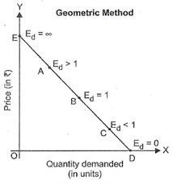
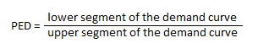
1.Point/Geometric Method
This method is used to measure the price elasticity
of demand at any given point in the curve.
According to this method, elasticity of demand will be different on each point of a demand curve.

Slide 27
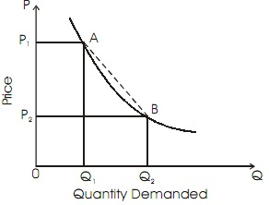
2.Arc Method
This method is used to find out price elasticity of demand over a certain range of price and quantity.
Thus, this method is applied while calculating PED when price (or)
quantity demanded of the commodity is highly changed.

Slide 28
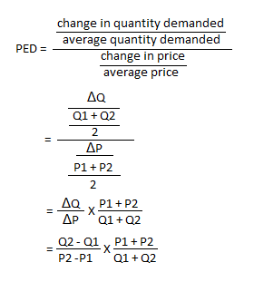
where
ΔQ=change in quantity demanded
Q1=original quantity
Q2=new quantity
ΔP=change in price of commodity
P1=original price
P2 =new price

Slide 29
3.Percentage Method
Percentage method is one of the commonly used approaches of measuring price elasticity of demand under which price elasticity is measured in terms of rate of percentage change in quantity demanded to percentage change in price.

Slide 30
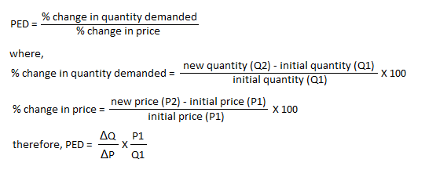

Slide 31
4.Total Outlay Method
Total outlay method also known as Total Expenditure Method of measuring price elasticity of demand was developed by Professor Alfred Marshall.
According to this method, price elasticity of demand can be measured by comparing total expenditure on a commodity before and after
the price change.

Slide 32
5.Revenue Method
Elasticity of demand can be estimated with the help of average revenue & marginal revenue.
When total revenue is divided by the number of units sold, we get average revenue.
When addition is made to the total revenue by the sale of one more unit of the commodity is called marginal revenue.
E_{d} = A/ A-M where A-average revenue
M-marginal revenue

Slide 33
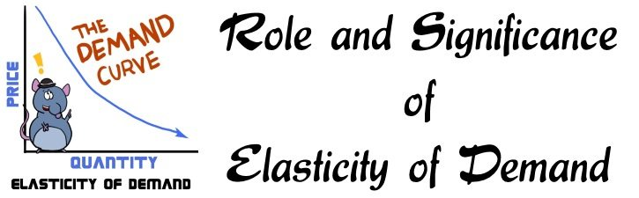

Slide 34
The concept of Elasticity of demand has significant role to play in economic theory and practice and we shall study the importance of this concept.
1. Elasticity of demand in production
2. Elasticity of demand in Price Fixation
3. Elasticity of demand in Distribution
4. Elasticity of demand in International Trade
5. Elasticity of demand in foreign Exchange
6. Elasticity of demand in nationalizing an Industry
7. Elasticity of demand in Public Finance

Slide 35

DEMAND FORECASTING

Slide 36
CHARACTERISTICS OF GOOD DEMAND FORCASTING
Forecasts are rarely perfect.
Forecasts based on aggregated data are more accurate than based on individual items.
Short range forecast are more accurate than long range forecast.
Quantitative (scientific and analytical)forecast are more accurate than qualitative(subjective)forecast.

Slide 37
STEPS IN DEMAND FORECASTING
1. Determining the objectives:
The first step in this regard is to consider the objectives of sales forecasting carefully.
2. Period of forecasting:
Before taking up forecasting, the company has to decide the period of forecasting — Whether it is a short-term forecast or long-term research.
3. Scope of forecast:
The next step is to decide the scope of forecasting Whether it is for the products, or for a particular area or total industry or at the national/international level.

Slide 38
4. Sub-dividing the task:
Sub-dividing the task into homogeneous groups, according to product, area, activities or consumers. The figure of sales forecasting shall be the sum total of the sales forecasts of all the groups.
5. Identify the variables:
The different variables or factors affecting the sales should be identified so that due weightage may be given to those different factors.
6. Selecting the method:
Appropriate method of sales forecasting is selected by the company taking into account all the relevant information, purpose of forecasting and the degree of accuracy required.

Slide 39
7. Collection and analysis of data:
Necessary data for the forecast are collected, tabulated, analyzed and cross-checked. The data are interpreted by applying the statistical or graphical techniques, and then to draw necessary deductions there from.
8. Study of correlation between sales forecasts and sales promotion plans:
Making the forecast reliable, the sales promotion plans such as advertising, personal selling and other sales programmes should be reviewed. A study of correlation between sales forecasts and sales promotion plans should be made in order to establish their role in promoting the sales.
9. Competitors activities:
Volume of sales of a company is largely affected by the activities of competitors and, therefore, the forecaster must also study the competitors’ activities, policies, programmes and strategies.

Slide 40
10. Preparing final sales forecasts:
The preliminary sales forecasts figure should be reviewed and final sales forecast figures should be arrived at after making all adjustments.
11. Evaluation and adjustments:
The figures of final sales forecasts form the basis for the operations of the company in the next period. The actual sales performance in the forthcoming period should be reviewed and evaluated from time to time viz, monthly, quarterly, half-yearly or yearly and so on. The forecast figures should be revised in the light of difficulties experienced during actual performance. At the end of the forecast period, actual performance should be reviewed and rectified while forecasting the demand for the next period.

Slide 41
SUPPLY ANALYSIS & LAW OF SUPPLY
Supply means a quantity of commodity which a seller is willing an able to offer for sale at various prices during a given period of time.
According to DODEY “Higher the price greater the quantity supplied and lower the price smaller the quantity supplied”.

Slide 42
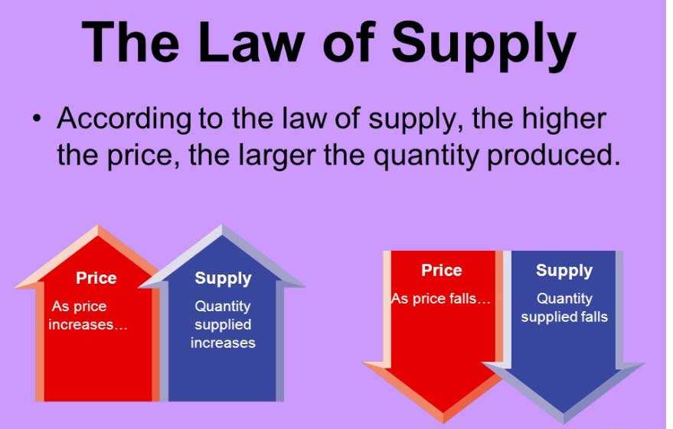
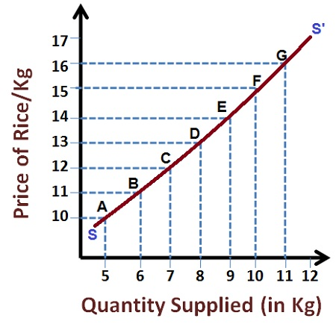

Slide 43
SUPPLY FUNCTION
Supply function shows the relationship between supply of a product and its determinant.
S x = Supply of product X
Px = Price of product X
Fe = Efficiency of factors of production
Fp = Price of factors of production
Fr = price of other related products
G = Goals of the firms
W = Weather conditions
E = Future Expectations
N = Number of firms
C = Other determinants
S x = f(Px,Fe,Fp,Pr,G,W,E,N,C)

Slide 44
CASE STUDY

Slide 45
2 MARKS QUESTIONS AND ANSWERS

Slide 46
DEMAND AND SUPPLY RELATED LINKS
https://youtu.be/kUPm2tMCbGE
https://youtu.be/nKvrbOq1OfI

Slide 47

THANK YOU

